Slide 1

IPL ANALYTICS
BY NIKHIL MOHANTY

Slide 2

Introduction
The Indian Premier League (IPL) is a professional Twenty20 cricket league established by the Board of Control for Cricket in India (BCCI) in 2008. It has quickly become one of the most popular and lucrative cricket leagues globally, featuring franchises representing major Indian cities.
This analysis is based on first 9 seasons of IPL strategize to improve the performance of one of the most loved team franchise – RCB.

Slide 3
Problem Statement
Being hired as a sports data analyst by RCB, where the team is focused on identifying top-performing and reliable players to secure tournament victories. Our objective is to evaluate both on-field performance and value for money in preparation for the mega player auction of 2017.
To achieve this, we will develop strategies and suggestions for selecting the best-performing players while optimizing our investments during the player auction.

Slide 4
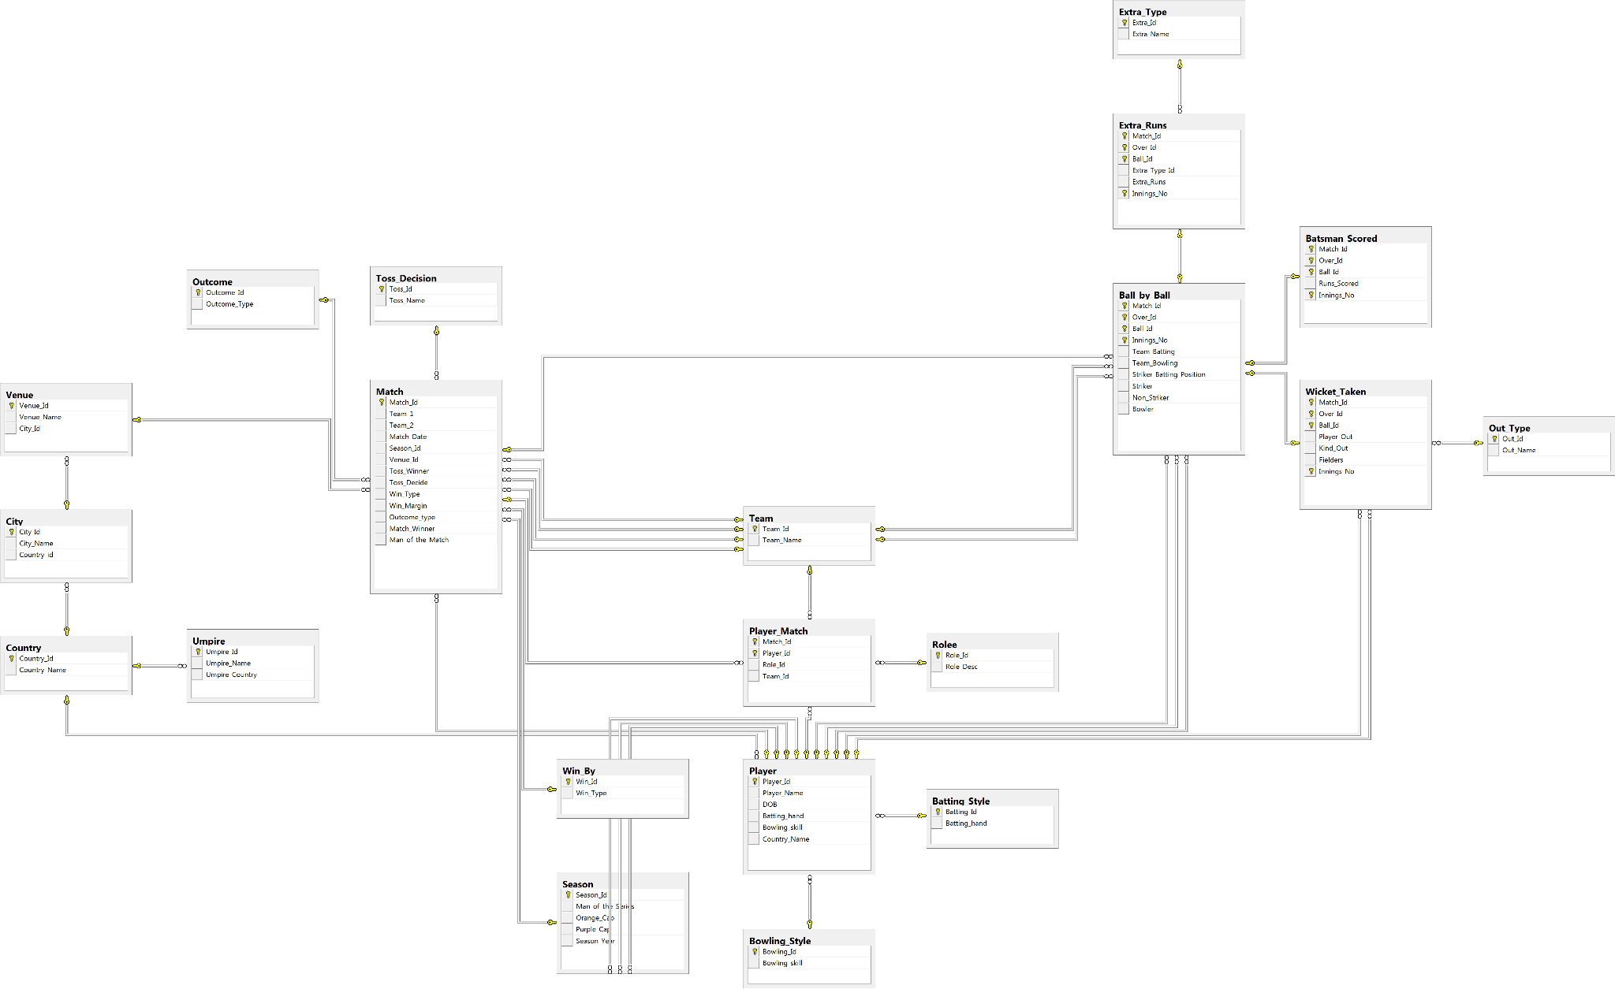
Database Schema

Slide 5
Data Overview
The dataset consists of total 22 tables : ball_by_ball, batsman_scored, batting_style, bowling_style, city, country, extra_runs, extra_type, matches, out_type, outcome, player, player_match, role, season, sysdiagrams, team, toss_decision, umpire, venue, wicket_taken & win_by.
From these 22 tables ball_by_ball, batsman_scored, extra_runs, matches, wicket_taken & win_by are considered as data tables while others are considered as Facts tables.
The dataset consists of approx. 3,00,000 rows.

Slide 6
Analytics & Insights
Runs scored by RCB in different seasons gradually increased but showed a huge dip in the season 7 & 8.
The potential reason could be the star players scoring less. Virat Kohli and Ab De Villiers scored drastically low runs in season 7 & 8.

Slide 7
Analytics & Insights
The top 10 batsman and their average scores per season can be visualized.
Here we can see Suresh Raina, Virat Kohli, Rohit Sharma topping the list.
We can see 3 batsman from RCB in the top 10 list (Virat Kohli, Chris Gayle & AB De Villiers)

Slide 8
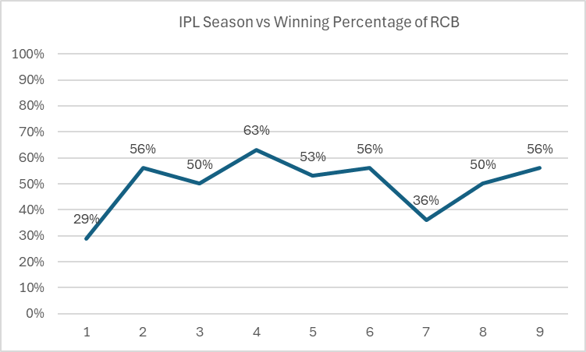
Analytics & Insights
RCB’s winning percentage is drastically low in season 1 & 7.
The winning percentage id derived by number of matches won / total matches played.
RCB’s winning percentage never exceeded 70%.

Slide 9
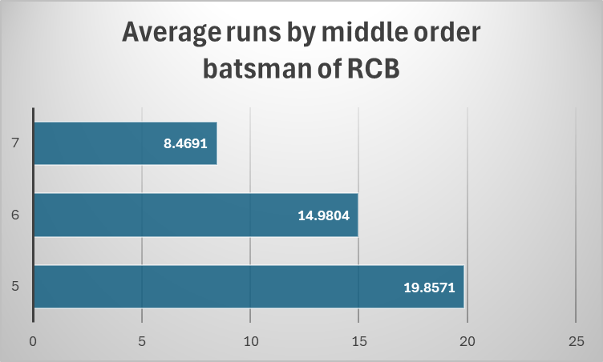
Analytics & Insights
The middle order of RCB batting line up (5,6,7) doesn’t have good batting average.
Due to the failure of middle order most of the matches RCB lost if the top order fails
Only the top order batsman have high averages in RCB

Slide 10

Analytics & Insights
The bowling average of bowlers in the death overs slide down to 9.365 that burdens the team with a loose end.
From the highest bowling averages

Slide 11
Strategic Recommendations
Strengthen the Bowling Attack
Focus on Death Bowlers
Look for bowlers with proven records in the death overs. Consider players who have consistently performed well in high-pressure situations like Dwayne Bravo, B Kumar, or young talents like Sandeep Sharma
Variety in Bowling
Ensure a mix of pacers and spinners to adapt to different pitch conditions. Consider acquiring all-rounders who can bowl as well.

Slide 12
Strategic Recommendations
Enhance the Middle Order
Middle-Order Stability
Target middle-order batsmen who can play under pressure and maintain a high strike rate. This will provide depth in batting and reduce reliance on star players like Kedar Jadhav or Ravindra Jadeja.
Flexibility in Batting Order
Looking for players who can bat in multiple positions, allowing for better tactical adjustments during matches.

Slide 13
Strategic Recommendations
Fielding Performance
Key Findings:
RCB has had issues with dropped catches and missed run-out opportunities.
Improving fielding could significantly impact match outcomes.
Solution:
Choose players who have a high fitness level along with high number of catches in the IPL

Slide 14
Conclusion
Performance Consistency: RCB has exhibited inconsistency in their overall performance, often failing to perform cohesively as a unit. At times, they excel in batting, while at other times, their bowling is strong, but rarely do both facets shine together.
Focus on Young Talent: To build a more dynamic and resilient team, RCB should prioritize the recruitment of young players who can bring energy and fresh perspectives to the squad.
Target Economical Death Bowlers: The team should focus on acquiring death bowlers who are economical and skilled at containing runs in crucial final overs, enhancing the team's ability to defend scores effectively.
Strengthening the Lower Middle Order: It is essential for RCB to address the performance of their lower middle order, ensuring that the batting lineup is robust and capable of delivering under pressure.

Slide 15
Thank YOU

